Slide 1
Gradient descent
By: Khaled Mohammed Abdelgaber
Teaching Assistant at Faculty of Engineering
Contact: Khaled.edu.engineer@gmail.com

Slide 2
Introduction
Gradient descent (GD) is an iterative first-order optimisation algorithm, used to find a local minimum/maximum of a given function.
uses only the first derivative (the gradient) of the function to guide its search for minima or maxima.
This method is commonly used in machine learning (ML) and deep learning (DL) to minimize a cost/loss function (e.g. in a linear regression).
Due to its importance and ease of implementation, this algorithm is usually taught at the beginning of almost all machine learning courses.
it relies on the slope of the function to decide the direction and size of each step, without using second derivatives or curvature information.

Slide 3
Usage areas
However, its use is not limited to ML/DL only, it’s widely used also in areas like:
  control engineering (robotics, chemical, etc.)
  computer games
  mechanical engineering

Slide 4
Function requirements
Gradient descent algorithm does not work for all functions. There are two specific requirements. A function has to be:
  Differentiable
  Convex

Slide 5
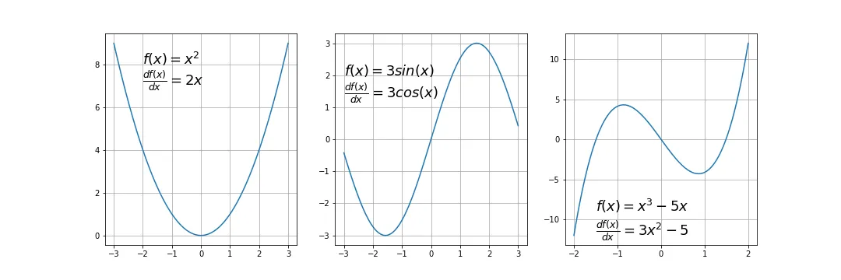
differentiable
If a function is differentiable it has a derivative for each point in its domain
Not all functions meet these criteria.
First, let’s see some examples of functions meeting this criterion:

Slide 6
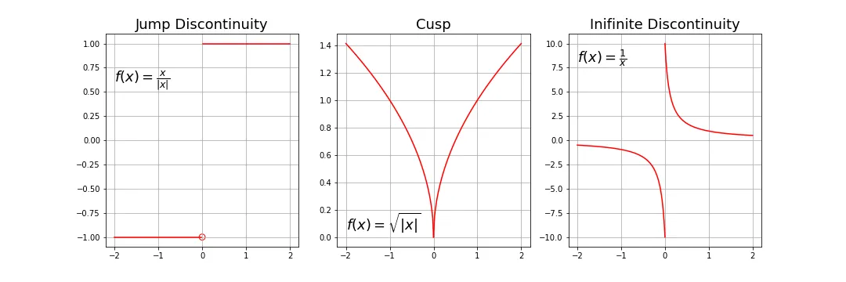
Cont.
Typical non-differentiable functions have a step a cusp or a discontinuity:

Slide 7
Convex function
this means that the line segment connecting two function’s points lays on or above its curve (it does not cross it).
If it does it means that it has a local minimum which is not a global one.
Mathematically, for two points x₁, x₂ laying on the function’s curve this condition is expressed as:
where λ denotes a point’s location on a section line and its value has to be between 0 (left point) and 1 (right point), e.g. λ=0.5 means a location in the middle.
Another way to check mathematically if a univariate function is convex is to calculate the second derivative and check if its value is always bigger than 0.

Slide 8
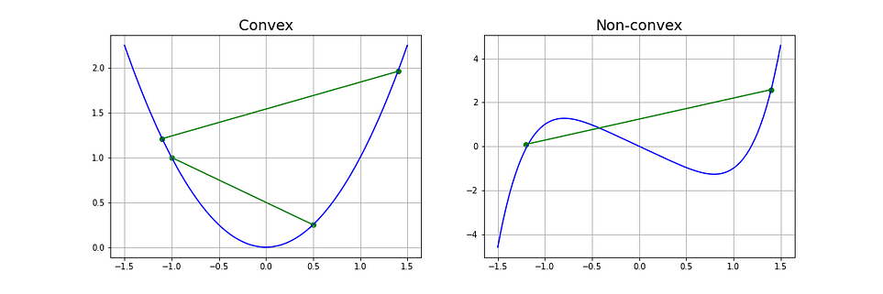
Cont.

Slide 9

Gradient
it is a slope of a curve at a given point in a specified direction.
In the case of a univariate function, it is simply the first derivative at a selected point.
In the case of a multivariate function, it is a vector of derivatives in each main direction (along variable axes).
Because we are interested only in a slope along one axis and we don’t care about others these derivatives are called partial derivatives.
A gradient for an n-dimensional function f(x) at a given point p is defined as follows:

Slide 10
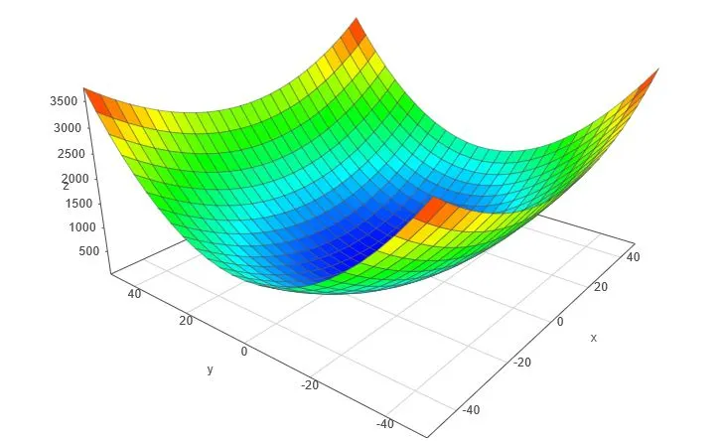
Cont.
The upside-down triangle is a so-called nabla symbol and you read it “del”.
To better understand how to calculate it let’s do a hand calculation for an exemplary 2-dimensional function below.

Slide 11
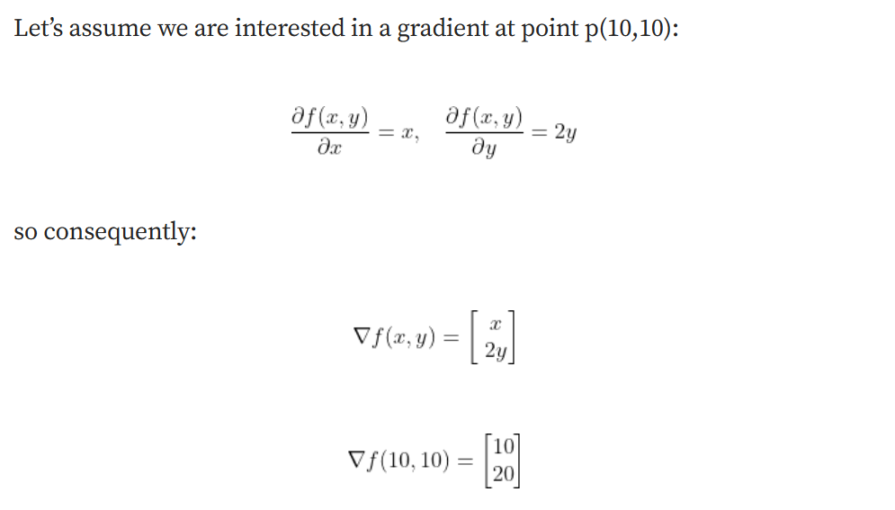
Cont.

Slide 12
Gradient Descent Algorithm
Gradient Descent Algorithm iteratively calculates the next point using gradient at the current position, scales it (by a learning rate) and subtracts obtained value from the current position (makes a step).
It subtracts the value because we want to minimise the function (to maximise it would be adding). This process can be written as:
There’s an important parameter η which scales the gradient and thus controls the step size.
In machine learning, it is called learning rate and have a strong influence on performance.
The smaller learning rate the longer GD converges, or may reach maximum iteration before reaching the optimum point
If learning rate is too big the algorithm may not converge to the optimal point (jump around) or even to diverge completely.

Slide 13
Cont.
In summary, Gradient Descent method’s steps are:
  choose a starting point (initialisation)
  calculate gradient at this point
  make a scaled step in the opposite direction to the gradient (objective: minimise)
  repeat points 2 and 3 until one of the criteria is met:
    maximum number of iterations reached
    step size is smaller than the tolerance (due to scaling or a small gradient).

Slide 14
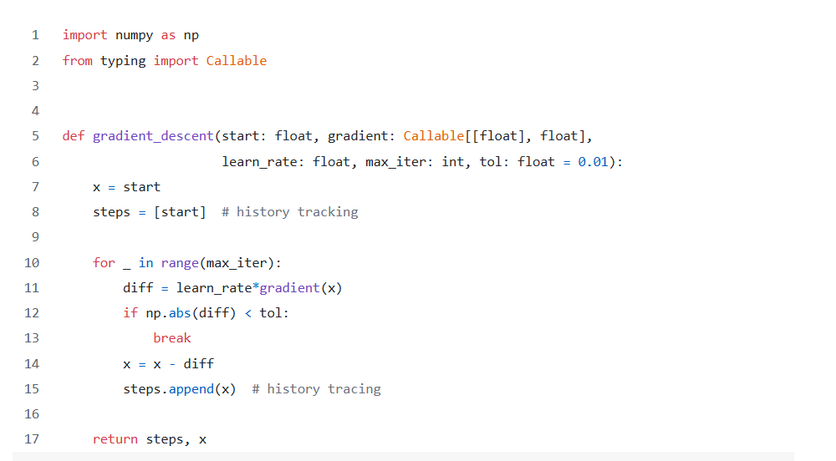
code

Slide 15
Cont.
This function takes 5 parameters:
  starting point [float] - in our case, we define it manually but in practice, it is often a random initialisation
  gradient function [object] - function calculating gradient which has to be specified before-hand and passed to the GD function
  learning rate [float] - scaling factor for step sizes
  maximum number of iterations [int]
  tolerance [float] to conditionally stop the algorithm (in this case a default value is 0.01)

Slide 16
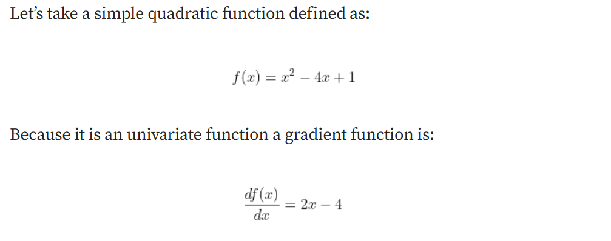
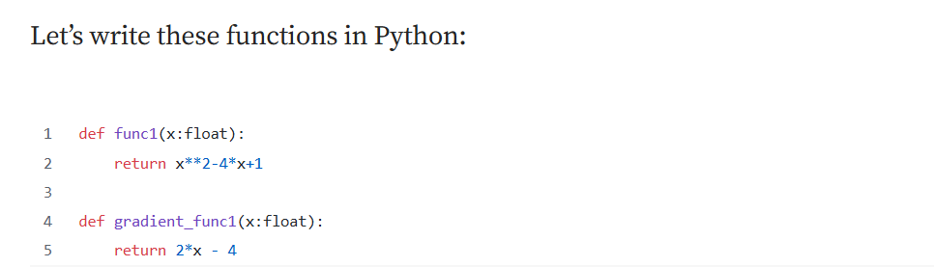
Example 1 — a quadratic function

Slide 17

Cont.
For this function, by taking a learning rate of 0.1 and starting point at x=9 we can easily calculate each step by hand.
Let’s do it for the first 3 steps:
The python function is called by:
  history, result = gradient_descent(9, gradient_func1, 0.1, 100)

Slide 18
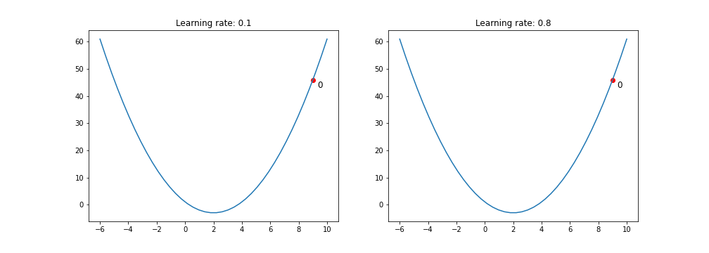
Learning rate effect
The animation below shows steps taken by the GD algorithm for learning rates of 0.1 and 0.8. As you see, for the smaller learning rate, as the algorithm approaches the minimum the steps are getting gradually smaller. For a bigger learning rate, it is jumping from one side to another before converging.

Slide 19
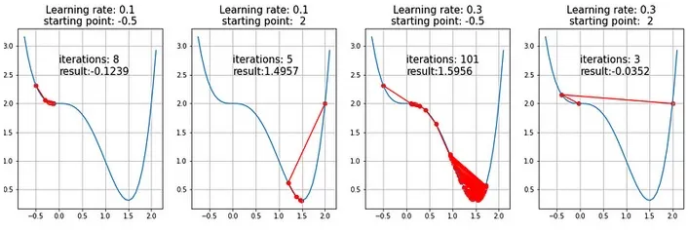
Example 2 — a function with a saddle point
Now let’s see how the algorithm will cope with a semi-convex function we investigated mathematically before.
Below results for two learning rates and two different staring points.

Slide 20
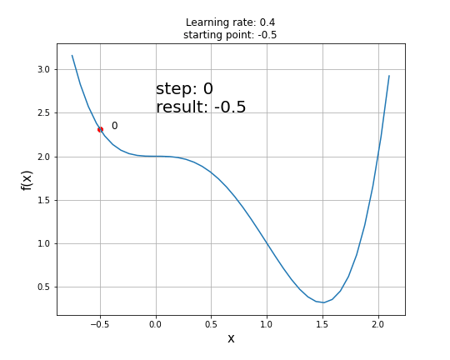

Slide 21
Linear Regression and Gradient Descent
Complete Mathematical Derivation

Slide 22
The Linear Regression Model
We want to model the relationship between input x and output y with a straight line:
ŷ = w₁x + w₀
Where:
  x is our input feature (independent variable)
  y is the actual output (dependent variable)
  ŷ is our predicted output
  w₁ is the weight/slope
  w₀ is the bias/intercept
For multiple data points, we have a dataset: {(x₁, y₁), (x₂, y₂), ..., (xₙ, yₙ)}

Slide 23
Defining the Error (Residual)
For each data point i, the error is:
eᵢ = yᵢ - ŷᵢ = yᵢ - (w₁xᵢ + w₀)
This is how far off our prediction is from the actual value.
ŷᵢ: model prediction
yᵢ: actual values [from the dataset]

Slide 24
The Cost Function (Mean Squared Error)
We want to minimize the total error across all data points. We use squared error because:
  It penalizes larger errors more heavily
  It's always positive
It's differentiable (smooth)
  J(w₀, w₁) = (1/n) Σᵢ₌₁ⁿ (yᵢ - ŷᵢ)²
Substituting our model:
  J(w₀, w₁) = (1/n) Σᵢ₌₁ⁿ (yᵢ - (w₁xᵢ + w₀))²
Expanding:
  J(w₀, w₁) = (1/n) Σᵢ₌₁ⁿ (yᵢ - w₁xᵢ - w₀)²
This is the function we want to minimize!

Slide 25
Deriving the Gradient (Partial Derivatives)
To minimize J, we need to find where its slope is zero. We calculate partial derivatives with respect to each parameter.
1. Partial Derivative with Respect to w₀
  ∂J/∂w₀ = ∂/∂w₀ [(1/n) Σᵢ₌₁ⁿ (yᵢ - w₁xᵢ - w₀)²]
  Using the chain rule: d/dx[f(x)²] = 2f(x)·f'(x)
  ∂J/∂w₀ = (1/n) Σᵢ₌₁ⁿ 2(yᵢ - w₁xᵢ - w₀) · ∂/∂w₀(yᵢ - w₁xᵢ - w₀)
The derivative of (yᵢ - w₁xᵢ - w₀) with respect to w₀ is -1:
  ∂J/∂w₀ = (1/n) Σᵢ₌₁ⁿ 2(yᵢ - w₁xᵢ - w₀) · (-1)
  ∂J/∂w₀ = -(2/n) Σᵢ₌₁ⁿ (yᵢ - w₁xᵢ - w₀)
Or more compactly:
  ∂J/∂w₀ = -(2/n) Σᵢ₌₁ⁿ (yᵢ - ŷᵢ)

Slide 26
Cont.
2. Partial Derivative with Respect to w₁
    ∂J/∂w₁ = ∂/∂w₁ [(1/n) Σᵢ₌₁ⁿ (yᵢ - w₁xᵢ - w₀)²]
  Again using the chain rule:
    ∂J/∂w₁ = (1/n) Σᵢ₌₁ⁿ 2(yᵢ - w₁xᵢ - w₀) · ∂/∂w₁(yᵢ - w₁xᵢ - w₀)
  The derivative of (yᵢ - w₁xᵢ - w₀) with respect to w₁ is -xᵢ:
    ∂J/∂w₁ = (1/n) Σᵢ₌₁ⁿ 2(yᵢ - w₁xᵢ - w₀) · (-xᵢ)
    ∂J/∂w₁ = -(2/n) Σᵢ₌₁ⁿ xᵢ(yᵢ - w₁xᵢ - w₀)
  Or:
    ∂J/∂w₁ = -(2/n) Σᵢ₌₁ⁿ xᵢ(yᵢ - ŷᵢ)

Slide 27
The Gradient Descent Update Rule
The gradient vector is:
  ∇J = [∂J/∂w₀, ∂J/∂w₁]ᵀ
To minimize J, we move in the opposite direction of the gradient:
  w₀ := w₀ - α · ∂J/∂w₀
  w₁ := w₁ - α · ∂J/∂w₁
Where α is the learning rate (step size).
Substituting our derivatives:
  w₀ := w₀ + α · (2/n) Σᵢ₌₁ⁿ (yᵢ - ŷᵢ)
  w₁ := w₁ + α · (2/n) Σᵢ₌₁ⁿ xᵢ(yᵢ - ŷᵢ)
Note: Often the factor of 2 is absorbed into the learning rate α.

Slide 28
Complete Step-by-Step Example

Slide 29
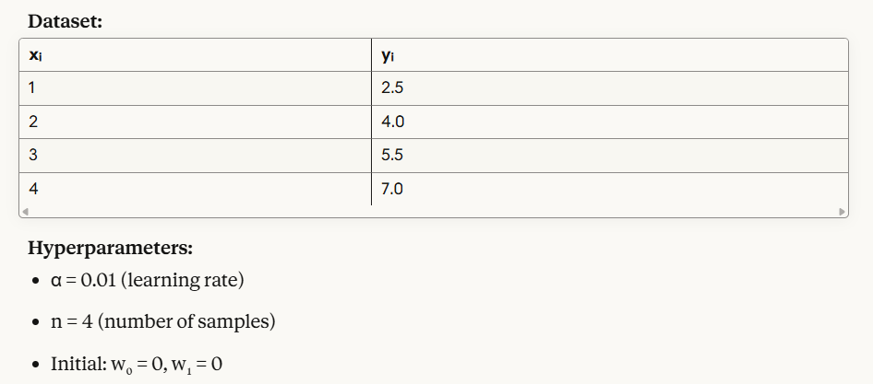
Complete example

Slide 30
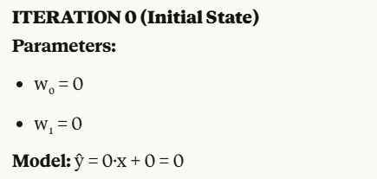
Cont.

Slide 31
ITERATION 1
Step 1: Compute Predictions
For each data point, compute ŷᵢ = w₁xᵢ + w₀:
  ŷ₁ = 0(1) + 0 = 0
  ŷ₂ = 0(2) + 0 = 0
  ŷ₃ = 0(3) + 0 = 0
  ŷ₄ = 0(4) + 0 = 0
Step 2: Compute Errors
  eᵢ = yᵢ - ŷᵢ:
  e₁ = 2.5 - 0 = 2.5
  e₂ = 4.0 - 0 = 4.0
  e₃ = 5.5 - 0 = 5.5
  e₄ = 7.0 - 0 = 7.0

Slide 32
cont
Step 3: Compute Cost
  J = (1/n) Σ(yᵢ - ŷᵢ)²
  J = (1/4)[2.5² + 4.0² + 5.5² + 7.0²]
  J = (1/4)[6.25 + 16.0 + 30.25 + 49.0]
  J = (1/4)(101.5)
  J = 25.375
Step 4: Compute Gradients
For w₀:
∂J/∂w₀ = -(2/n) Σ(yᵢ - ŷᵢ)
∂J/∂w₀ = -(2/4)[2.5 + 4.0 + 5.5 + 7.0]
∂J/∂w₀ = -(0.5)(19.0)
∂J/∂w₀ = -9.5
Step 4: Compute Gradients
For w₁:
  ∂J/∂w₁ = -(2/n) Σ xᵢ(yᵢ - ŷᵢ)
Let's compute term by term:
  x₁(y₁ - ŷ₁) = 1(2.5) = 2.5
  x₂(y₂ - ŷ₂) = 2(4.0) = 8.0
  x₃(y₃ - ŷ₃) = 3(5.5) = 16.5
  x₄(y₄ - ŷ₄) = 4(7.0) = 28.0
Sum = 2.5 + 8.0 + 16.5 + 28.0 = 55.0
  ∂J/∂w₁ = -(2/4)(55.0)
  ∂J/∂w₁ = -(0.5)(55.0)
  ∂J/∂w₁ = -27.5

Slide 33
Cont.
Step 5: Update Parameters
w₀ := w₀ - α(∂J/∂w₀)
w₀ = 0 - 0.01(-9.5) = 0 + 0.095
w₀ = 0.095
w₁ := w₁ - α(∂J/∂w₁)
w₁ = 0 - 0.01(-27.5) = 0 + 0.275
w₁ = 0.275

Slide 34
ITERATION 2
ITERATION 2
Parameters:
w₀ = 0.095
w₁ = 0.275
Model: ŷ = 0.275x + 0.095
Step 1: Compute Predictions
ŷ₁ = 0.275(1) + 0.095 = 0.370
ŷ₂ = 0.275(2) + 0.095 = 0.645
ŷ₃ = 0.275(3) + 0.095 = 0.920
ŷ₄ = 0.275(4) + 0.095 = 1.195

Slide 35
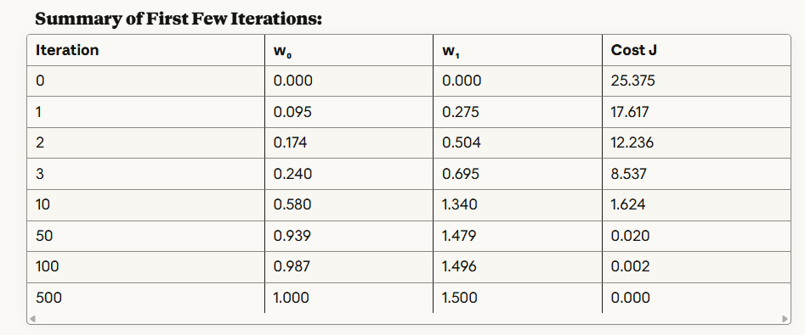
After training iteration repeatition

Slide 36
Convergence:
After many iterations, the algorithm converges to:
  w₀ ≈ 1.0 w₁ ≈ 1.5
Our final model: ŷ = 1.5x + 1.0
Let's verify with our data:
  x=1: ŷ=2.5 ✓
  x=2: ŷ=4.0 ✓
  x=3: ŷ=5.5 ✓
  x=4: ŷ=7.0 ✓
Perfect fit!

